Slide 1
Examination of The Respiratory System
Anteneh E. MD
May, 2024

Slide 2
Objectives of the lecture
To describe basic approach to respiratory system examination
To explain the ‘ Four cardinal steps’ of respiratory system examination
To describe common physical findings in some clinical conditions

Slide 3
Common Clinical Presentations
Cough
Shortness of breath (dyspnea)
Chest pain
Wheezing
Blood-streaked sputum (hemoptysis)

Slide 4
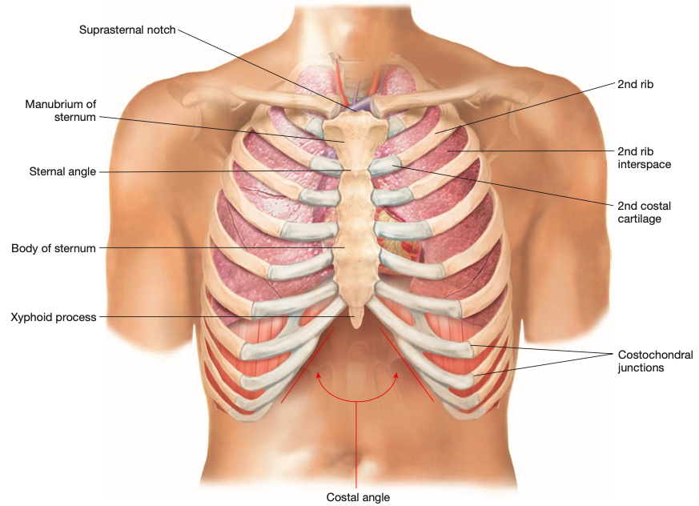
Basic Anatomy

Slide 5
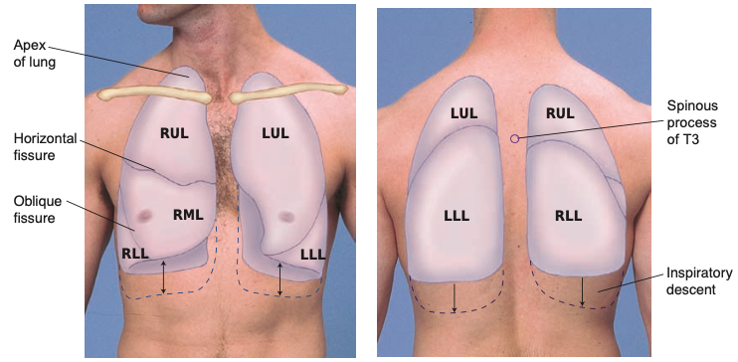

Slide 6
Techniques of Examination
General examinations
Cardinal steps of physical examination: Anterior and Posterior chest
Inspection
Palpation
Percussion
Auscultation

Slide 7
Inspection
Observe the rate, rhythm, depth, and effort of breathing.
Always inspect the patient for any signs of respiratory difficulty.
Assess the patient’s color for cyanosis.
Peripheral cyanosis
Central cyanosis
Clubbing of digits
Listen to the patient’s breathing.
Stridor and audible wheezes
Inspect for the use of accessory muscles: the SCM and scalene muscles
Supraclavicular retraction? Is the trachea midline?
Observe the shape of the chest: Lateral diameter > AP diameter

Slide 8
Inspection …
From a midline position behind the patient, note the shape of the chest and how the chest moves, including:
Deformities or asymmetry in chest expansion
Abnormal retraction of the interspaces during inspiration.
Retraction is most apparent in the lower interspaces.
Impaired respiratory movement on one or both sides or a unilateral lag (or delay) in movement.

Slide 9
Palpation
Identify tender areas.
Assess any visible abnormalities such as scars, chest drains, masses or sinus tracts.
Test chest expansion.
Place your thumbs at about the level of the 10th ribs.
Feel for tactile fremitus.
Palpate and compare symmetric areas of the lungs
Assess the position of trachea.

Slide 10
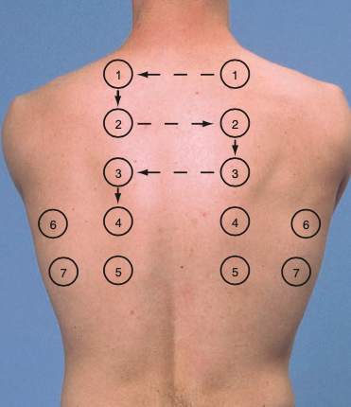
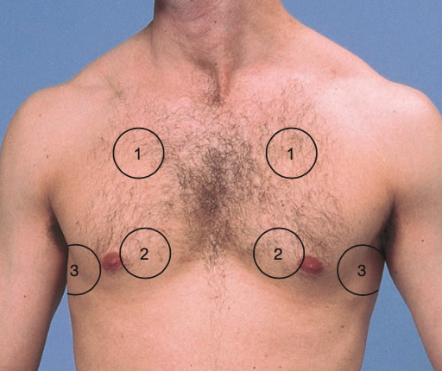

Slide 11
Percussion
Percuss one side of the chest and then the other at each level in a ladder-like pattern.
Healthy lungs are resonant.
Flat/stony dullness
Relative dullness
Resonant
Hyperresonant/ tympanitic
Estimate the extent of diaphragmatic
It is normally about 3 to 5.5 cm.

Slide 12
Auscultation
Auscultation involves:
Listening to the sounds generated by breathing:
Vesicular, bronchovesicular, tracheal and bronchial
Listening for any adventitious (added) sounds:
Crackles (rales), wheezes, and rhonchi
If abnormalities are suspected, listening to the sounds of the patient’s spoken or whispered voice as they are transmitted through the chest wall.
Egophony, bronchophony, whispered pectoriloquy.

Slide 13
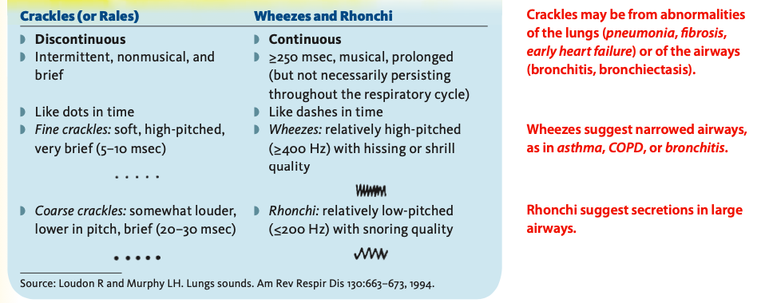
Added/ Adventitious Breath Sounds

Slide 14
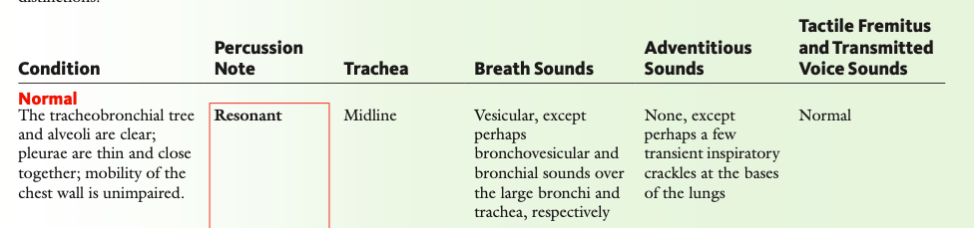
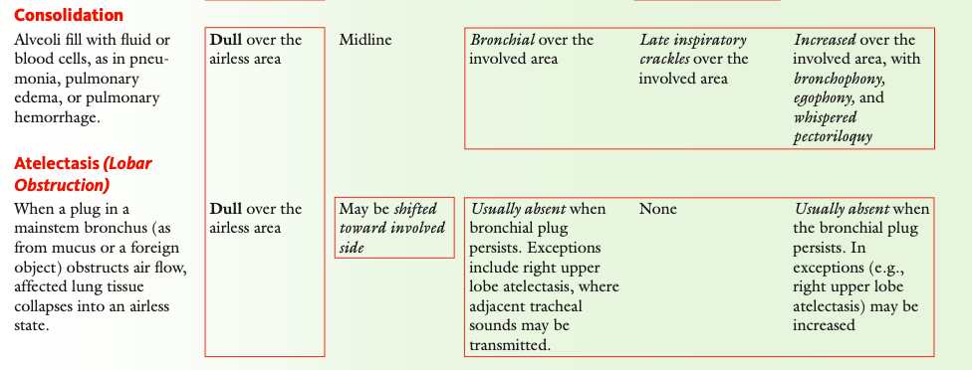

Slide 15
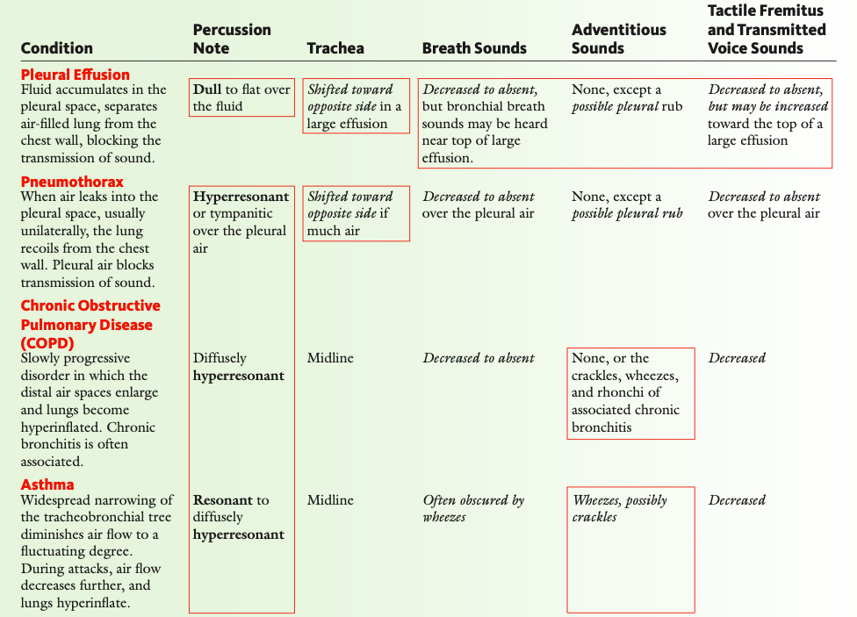

Slide 16
Thank you

